Slide 1
Accuracy

Slide 2
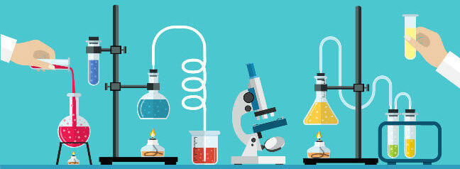
By the end of this Smart Lesson you should be able to:
Define what accuracy is.
Explain how to ensure accuracy in experiments.

Slide 3
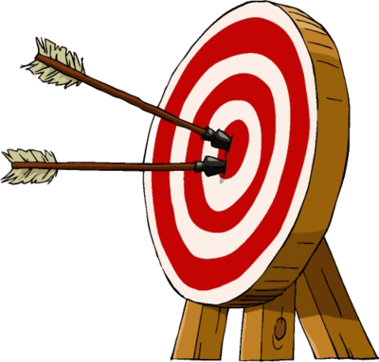
So what is accuracy?
Accuracy is how close a measured value is to the actual (true) value of a physical quantity.
Often, in science, measuring equipment will never produce a truly accurate quantity.
But using the correct equipment can help make a measurement as accurate as possible.

Slide 4

Accuracy is important to keep in mind when choosing equipment to use in your experiment.
For example, if you need to measure out 20 mL of water, you are more likely to get an accurate measurement if you use a measuring cylinder than if you use a beaker.

Slide 5
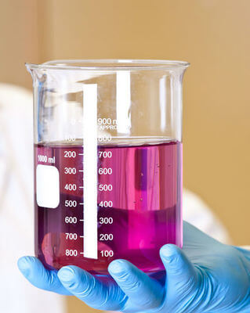
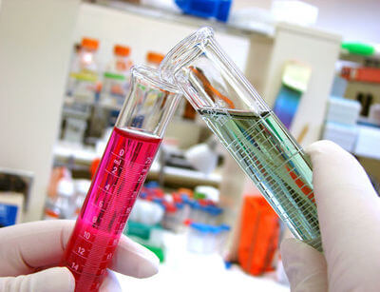
This is because a measuring cylinder is designed to give more accurate measurements than a beaker, which is designed for roughly measuring large volumes.
This means that choosing a measuring cylinder for your measurement will give you a quantity closer to the true 20 mL value than measuring in a beaker would.

Slide 6
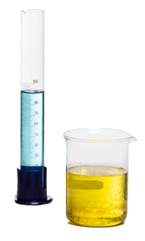
For example, you may measure what appears to be 20 mL of water, in both a 100 mL measuring cylinder and 100 mL beaker.
However, when you pour both measurements into 50mL measuring cylinders, the beaker produces 26 mL of water, while the water measured in the 100 mL measuring cylinder produces 20 mL.

Slide 7

Likewise, if you needed to measure out 8 mL of water, a 10 mL measuring cylinder would produce more accurate results than a 100 mL measuring cylinder would.
This is because the 10 mL measuring cylinder is designed for smaller measurements, so will produce a measurement closer to the true value of 10 mL.

Slide 8
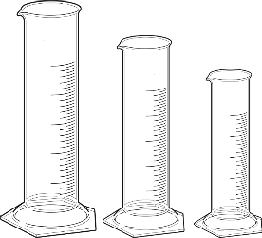
Choose equipment that is specifically designed for the purpose you require it for.
When measuring, choose the measuring cylinder with the closest value above the volume you want to measure.
For example:
To measure an 8 mL volume, use a 10 mL measuring cylinder instead of a 20 mL measuring cylinder.
To measure a 32 mL volume, use a 50 mL measuring cylinder instead of a 100 mL measuring cylinder.

